Slide 1
Shri Mataji’s Divine Heritage
Save All Her Divine Words everywhere
Compile talks and films per country

Slide 2
Shri Mataji’s Divine Heritage
Publication per country divided in II parts:
Part I – all talks given by Shri Mataji during Her visits to the country:
Public programs, Poojas, Formal and Informal Talks;
All events illustrated by as many photos as possible.
Part II – stories written by Sahaja Yogis,
also illustrated by photos

Slide 3
Shri Mataji’s Divine Heritage
Steps per country:
- Create an exhaustive list of visits and events
- creation of work groups: research, compilation, editing
- collection and editing of private diaries
- cooperation between countries, exchange of information

Slide 4
Shri Mataji’s Divine Heritage
Final publications to be sent to Nirmal Vidya-Amruta

Slide 5
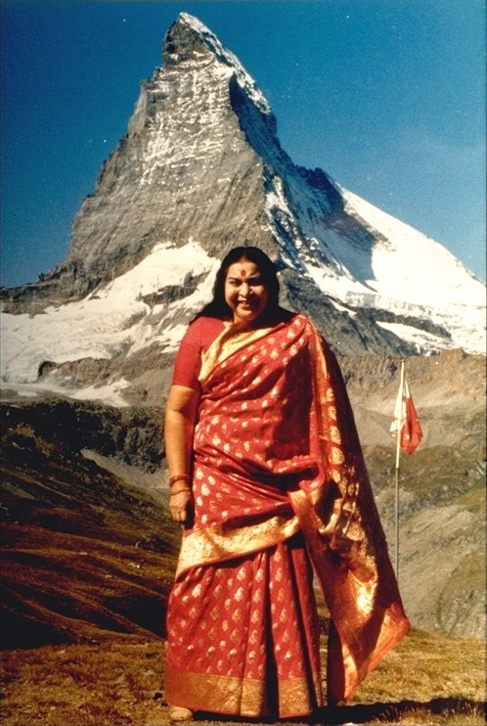
Shri Mataji in Switzerland
Exemple of what is being done in Switzerland
list of events of Shri Mataji for the first 2 years :

Slide 6
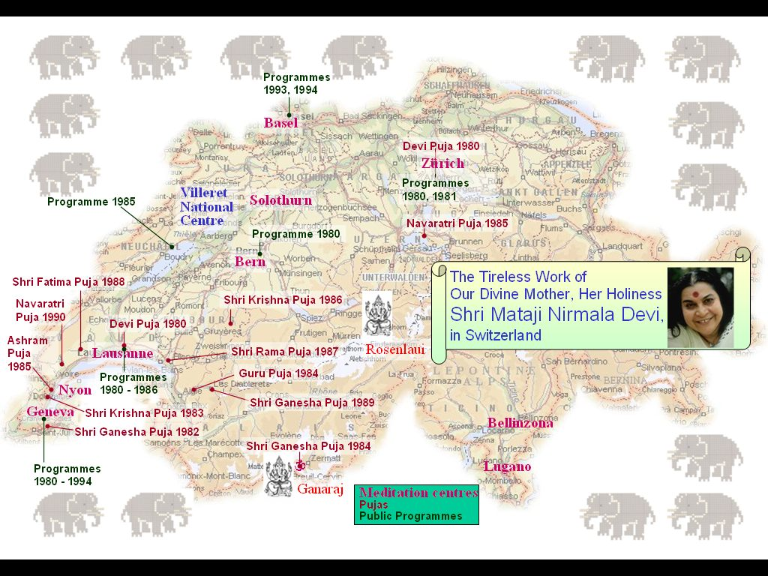
Shri Mataji in Switzerland

Slide 7
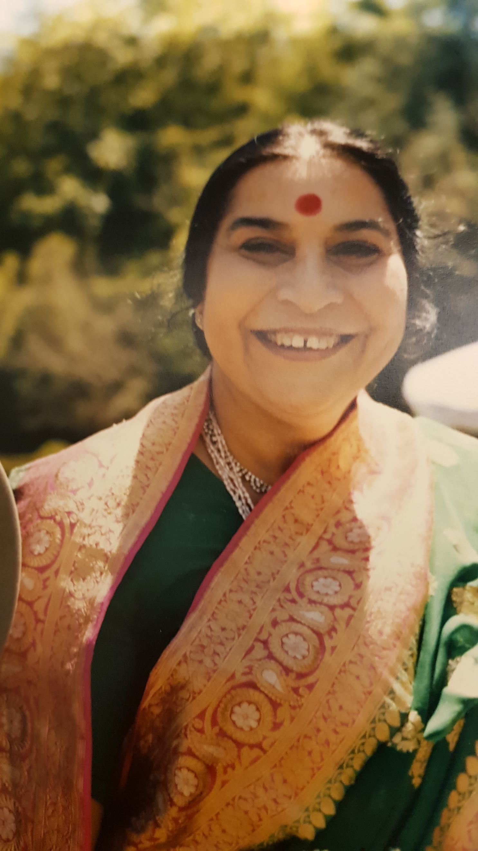
Shri Mataji in Portugal
Exemple of what is being done in Portugal
List of events of Shri Mataji in the country

